Slide 1
U.S. Tobacco GAP – Barn Testing Procedure
“We Bring Engineering to Life”

Slide 2
Barn Testing Overview
Flue-cured barn heating system integrity assessment
Heating systems must be tested every 3 years for CO₂ emissions
The cost and scheduling of testing is the responsibility of the grower
Testing can be conducted by independent third-party companies or individual growers, but all entities testing barns for the US Tobacco GAP Program must attend a Cooperative Extension training
Common testing procedure and reporting form
Barn testing records are to be kept by the contract grower

Slide 3
TSNA Formation
TSNA formation in flue-cured tobacco
(1) Naturally occurring microbial process
(2) Exposure to Nitrogen Oxide compounds from the combustion process react with alkaloids in the green leaf during the curing process
Mechanism (2) >> (1)

Slide 4
Why measure CO₂?
Typical stack gas CO₂ levels >> 1 ppm
10% to 13.5% (Actual)
Equipment cost and complexity
Commercially available meters
Simple and direct process
Portable instrumentation
Typical Ambient CO₂ Levels
300 – 500 ppm

Slide 5
Step 1: Barn Testing Report Preliminary Information
Farmer or Farm name and address
Location of barns
Testing date
Total number of barns to be tested
Testing entity company name or individual name
CO₂ probe serial number and calibration information
Barn ID numbers
If barns are tested at multiple locations for an individual farm
then separate reports should be completed to record the location
of the barns.

Slide 6
Step 2: Barn Settings
Prior to conducting the initial measurements, make sure:
Barn is at ambient (outside) temperature and empty.
Fan is ON
Heat is OFF
Fresh air dampers are CLOSED.

Slide 7
Step 3: Conducting the Barn Test
Leave the fan ON
Record the initial (ambient) CO₂ level inside the barn
Advance the thermostat 20º to 30ºF above the ambient air temperature to ensure the burner will run continuously for 10 minutes.
Depending on the ambient temperature, the thermostat set point above ambient that will result in the burner operating continuously for 10 minutes may be less than 20ºF.
Continue to monitor the levels for approximately 10 minutes after the burner ignites and record the final (10 minute) CO₂ measurement.

Slide 8
Step 4: Heat Exchanger Status
Calculate the difference between the barn initial (ambient) CO₂ level and the final (10 minute) CO₂ measurement.
If the difference measured is LESS than 200 ppm, the heat exchanger status is PASS.
If the difference measured is GREATER than 200 ppm, the heat exchanger status is FAIL and must be retested after repairs are made.
Barns with a FAIL status must both be repaired and retested or removed from service.
Results of the barn testing along with a copy of the CO₂ probe calibration are to be left with the grower.

Slide 9
Barn Testing Notes:
Allow the CO₂ meter to warm up for approximately 5 minutes initially.
Observe the maximum operating environment temperature specified by the CO₂ meter manufacturer. This typically ranges from 120ºF to 140ºF. The meter probe may be placed inside the barn through the front exhaust vent or, if available, access doors at the rear of the barn.
Typical ambient CO₂ levels range from 300 ppm to 500 ppm. Ambient readings outside this range may indicate a faulty CO₂ probe or instrument error.
If the CO₂ level increase exceeds 200 ppm prior to the burner operating for 10 minutes continuously, the procedure may be stopped and the barn status listed as FAIL.

Slide 10
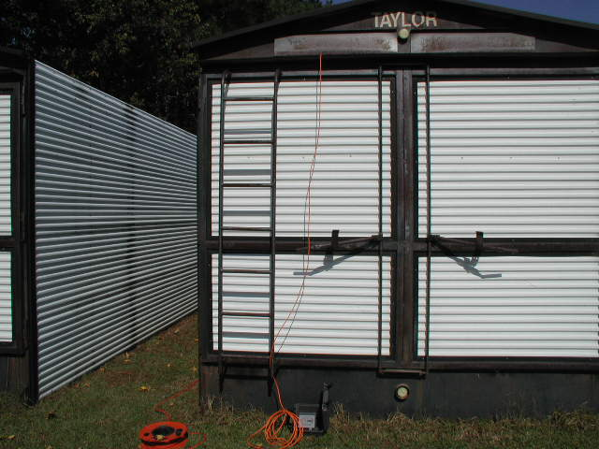
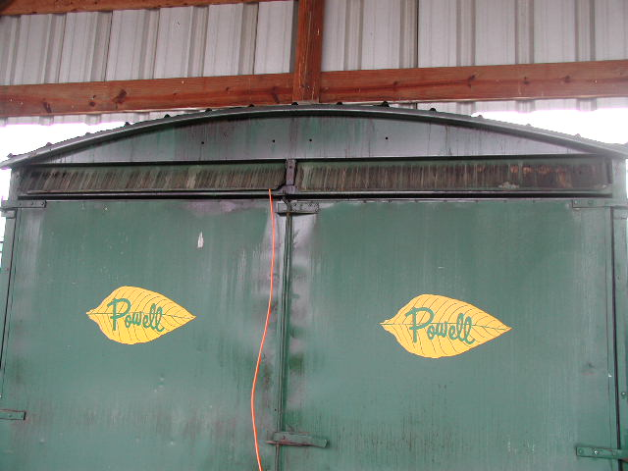
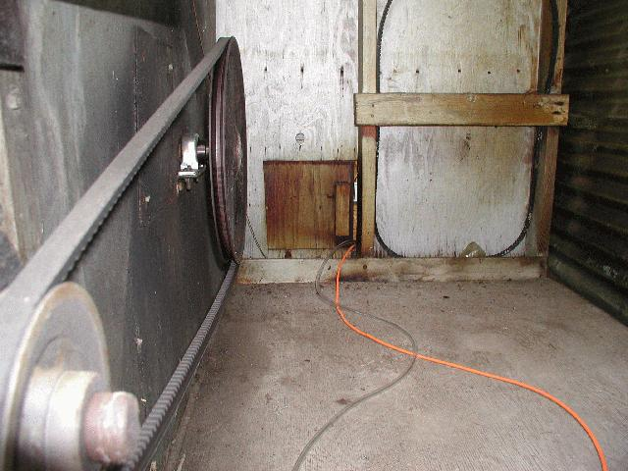
Examples of Probe Placement Inside the Barn

Slide 11
Commercial CO₂ Meters and Recommended Specifications
Extech EA90 (www.extech.com/instruments/)
Testo 535 (www.testo.com)
Vaisala GM70 or Indigo 201 (www.vaisala.com)
Recommended Minimum Specifications
Resolution: 1 ppm CO₂
Accuracy: +/- 50 ppm CO₂
Measurement Range: 0 – 5,000 ppm (less if available)
CO₂ sensor calibration certificate

Slide 12
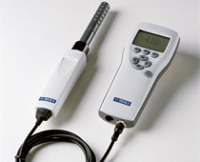
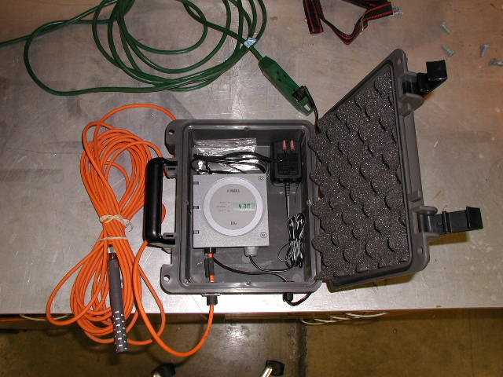
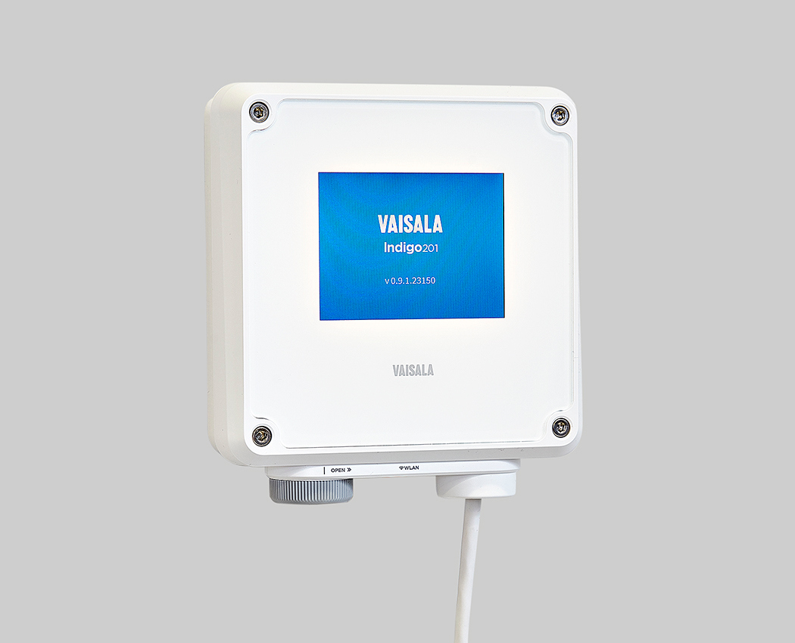
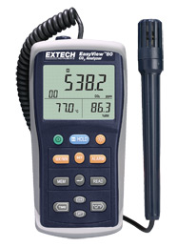
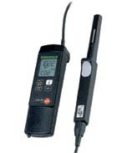
Carbon Dioxide Meters
Vaisala GM70
*Vaisala GMT222
(No longer available)
Vaisala Indigo 201
Testo
535
Extech
EA80

Slide 13
Common Sources of Leaks
Inspect all exhaust flue-pipe joints (elbows, etc.), if applicable, that are located inside the barn.
Especially flue-pipe joints that are simply connected with sheet metal screws and/or some type of compression or clamp style fittings. Some of these connections are located directly in the return air stream, which typically is the low-pressure side of the fan.
Also the floor style heat exchanger systems that use multiple pipes spanning the length of the barn should be checked for connection leaks.
A high temperature sealant may be needed in addition to any mechanical fasteners to properly seal the connection from leaking exhaust gases. The best solution would be to minimize or eliminate the flue-pipe connections located inside the barn.

Slide 14
Leaks – continued
Closely inspect the heat exchanger surfaces for cracks.
The firebox or combustion chamber, which typically will be the hottest part on the heat exchanger, may be the first location on the heat exchanger to develop cracks.
Also closely inspect all weld joints. Flame impingement or direct contact with firebox surfaces can accelerate cracking.

Slide 15
Leaks – continued
Although the CO₂ test is not used to determine if the stack exhaust gases are being pulled back into the barn when the fan fresh air intake vents are open, growers should be aware of the stack height relative to the top of the barn.
It is possible that exhaust gases could be pulled back into the barn when the vents are open even if the heat exchanger and other sources mentioned are not leaking.
This is especially the case during leaf drying when ventilation is typically at a maximum. The stack height should meet the minimum recommended height of 24 inches above the highest point of the barn roof.

Slide 16
Vaisala CO₂ Meter Update
Vaisala GMT 222 unit has been replaced with Indigo 201 unit
$464
$150 (10 m (33 ft) cable for probe)
Vaisala GMP 252 CO₂ probe for ppm measurements (0 - 2,000 ppm)
$828
$338 (probe recalibration)
Total = $1,442 (meter, probe, cable)
Indigo 80 (replaced GM70) portable CO₂ meter
$1900 (w/o probe and cable)
Vaisala will continue to support GMT 222 products for several years
Two GM70 units are available and calibration maintained that can be used as needed by Agents or growers
Rachel Falconer | Technical Inside Sales, Vaisala Inc.
Industrial Measurements Division – North America
3 Van de Graaf Drive, Burlington, MA, 01803
Email: rachel.falconer@vaisala.com
Tel (direct): 781-537-1051

Slide 17
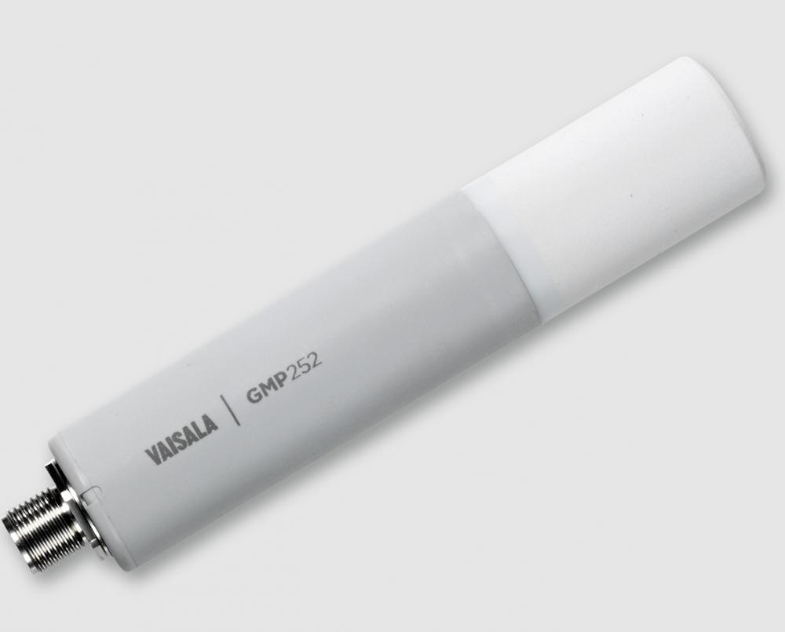
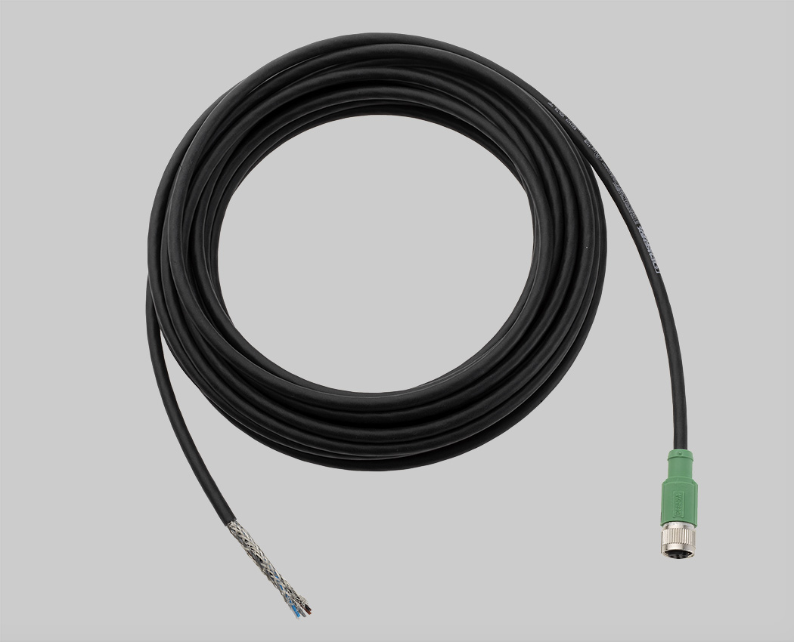
Vaisala GMP 252 CO₂ Probe and Indigo-201Transmitter
10 m (32.8 ft) cable
http://www.vaisala.com/en/products/carbondioxide/Pages/GMP252.aspx
http://www.vaisala.com/en/industrialmeasurements/products/accessories/Pages/Indigo-201.aspx

Slide 18
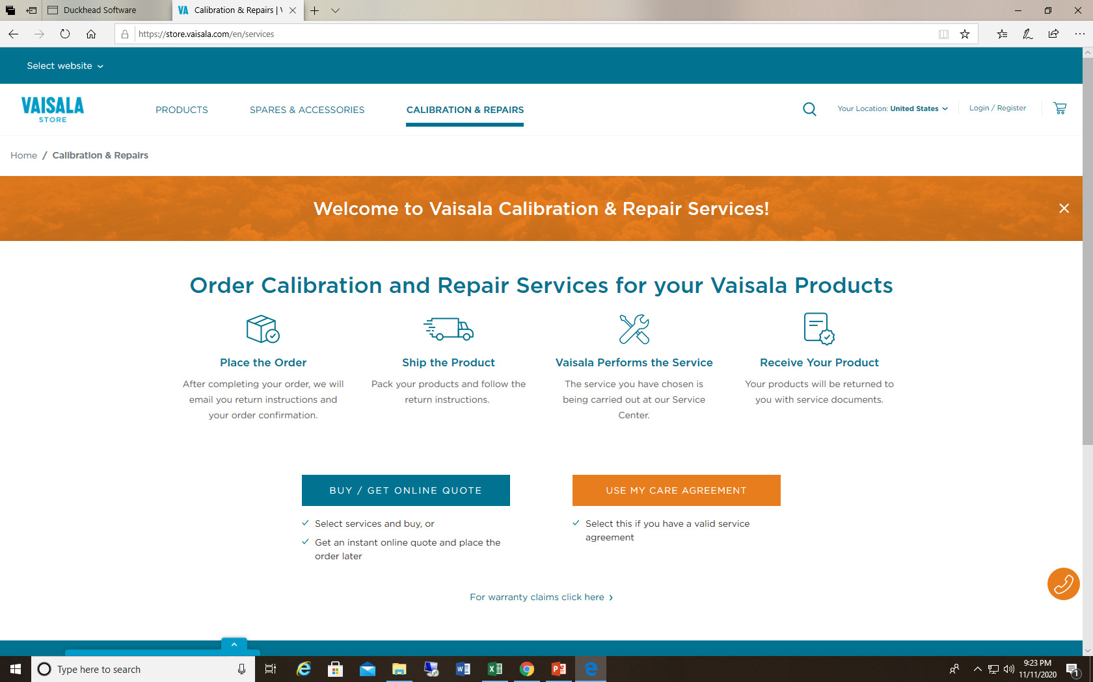
Vaisala Calibration and Repairs Services
https://store.vaisala.com/en

